Slide 1
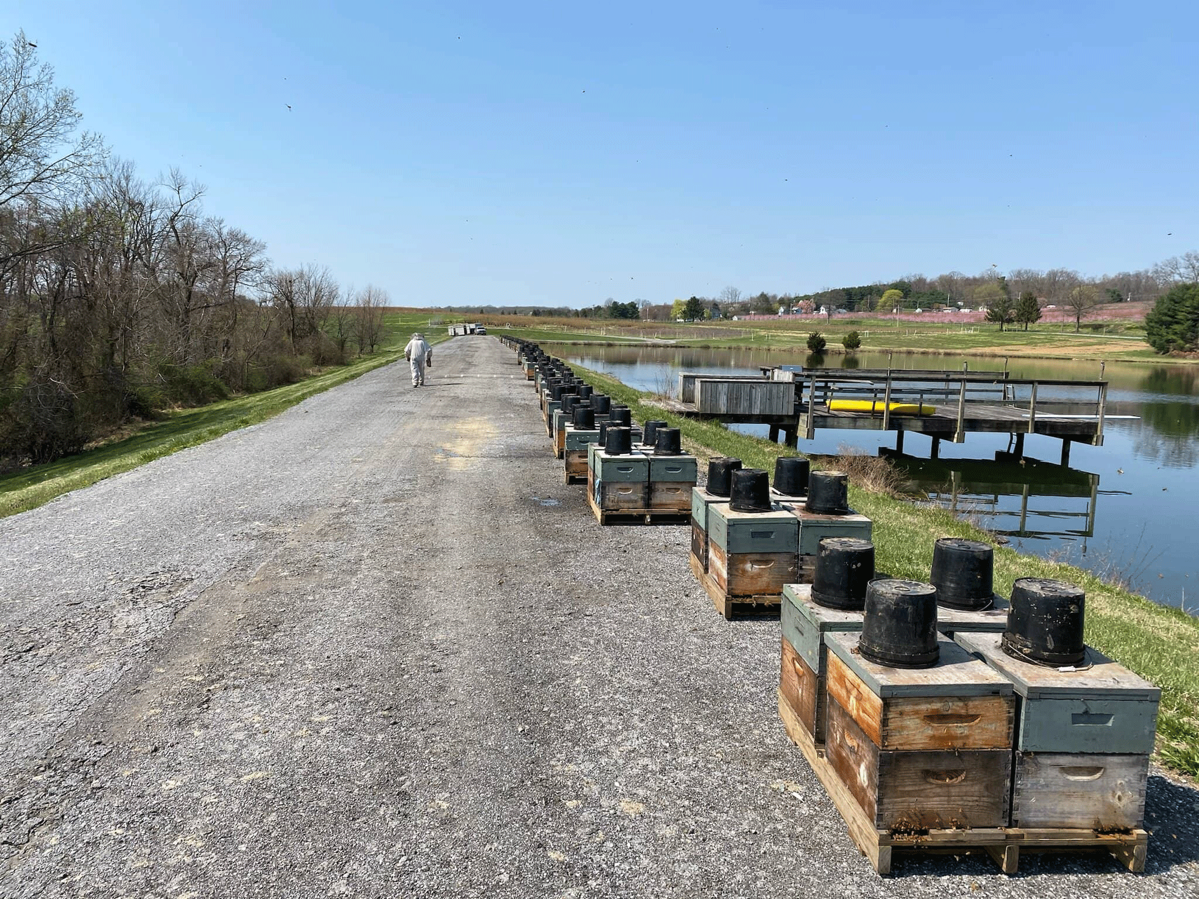
Bee Informed Partnership
Annual Loss & Management Survey
2022 Special Focus: Nutrition and Environment (nectar flows, feeding, pollination events, weather, etc.)
Help us estimate the level of US honey bee colonies lost in 2021 through 2022
Bee counted!
Live from April 1st to 30th
Take the survey at beeinformed.org

